Slide 1

Introduction to Evolutionary Algorithms（进化算法）
Yong Wang
School of Automation
Central South University
ywang@csu.edu.cn
https://intleo.csu.edu.cn/

Slide 2
Why Evolutionary Algorithms? (1/2)
What is the limitation of traditional optimization methods?
（传统优化方法）
single modal（单峰）
multiple modals（多峰）
The optimal solution!
The optimal solution（最优解）
Is it the optimal solution?

Slide 3

Why Evolutionary Algorithms? (2/2)
How about searching from different directions?
The optimal solution!

Slide 4

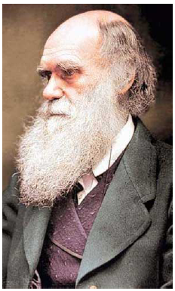
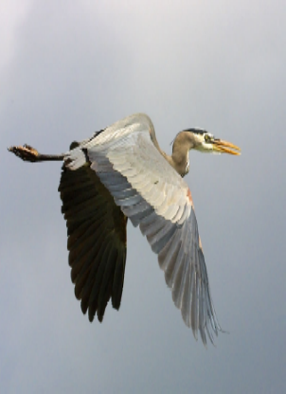
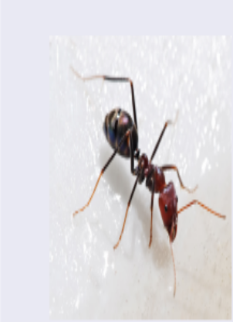
What Are Evolutionary Algorithms?
Evolutionary algorithms (EAs) are intelligent optimization techniques inspired by nature（受自然界启发）
genetic algorithm
（遗传算法）
particle swarm optimization
（粒子群优化算法）
ant colony algorithm
（蚂蚁算法）

Slide 5
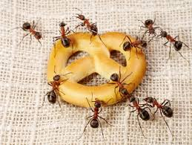

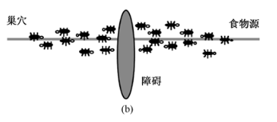
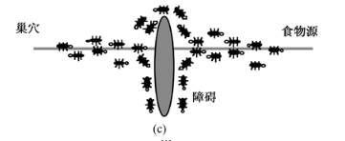
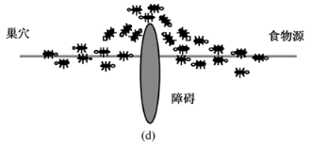
What Are Evolutionary Algorithms?
Why can ants find food?

Slide 6
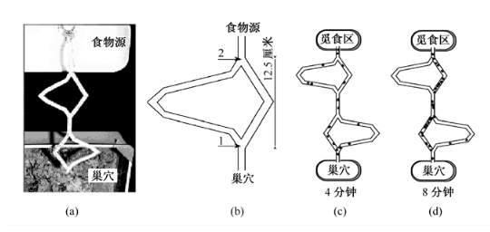
What Are Evolutionary Algorithms?
Why can ants find food on the shortest path?
Ants can release a special smell (pheromone)!

Slide 7
The Framework of Evolutionary Algorithms
the first individual（个体）
the second individual
Population（群体）
Selection（选择）
the NPth individual
Replacement
（替换）
Parent Set（父代集）
Crossover（交叉）
+
Mutation（变异）
New Solutions（新解）

Slide 8
The Characteristics（特点） of Evolutionary Algorithms
Search for the optimal solution from many points rather than one point
Choose the individuals based on the fitness function（适应值函数） and do not need the gradient information（梯度信息） of the optimization problems
Use the random probability transition rule（随机概率转变准则） rather than the deterministic transition rule（确定性转变准则）

Slide 9
The Main Paradigms（范例） of Evolutionary Algorithms
Genetic Algorithm
Evolution Strategy
Evolutionary Programming
Ant Colony Optimization
Particle Swarm Optimization
Differential Evolution
…
The classic paradigms of
evolutionary algorithms

Slide 10
Top Journals（期刊） in Evolutionary Computation Community
IEEE Transactions on Evolutionary Computation (since 1997)
Evolutionary Computation (since 1993)
IEEE Transactions on Cybernetics
IEEE Transactions on Emerging Topics in Computational Intelligence
IEEE Transactions on Systems, Man, and Cybernetics: Systems
IEEE Transactions on Artificial Intelligence

Slide 11
Top Conferences（会议） in Evolutionary Computation Community
IEEE Congress on Evolutionary Computation (CEC, Frequency: every year)
Genetic and Evolutionary Computation Conference (GECCO, Frequency: every year)
Evolutionary Multi-Criterion Optimization (EMO, Frequency: every two years)

Slide 12
Keywords
Evolutionary Algorithms（进化算法）
Paradigms（范例）
Evolutionary Computation（进化计算）
The optimal solution（最优解）
Fitness function（适应值函数）
Individual（个体）
Population（群体）

Slide 13


